Slide 1


Staff detection with marker from a top-view camera
Iezzi Christian - Incicco Emanuele

Slide 2
OUTLINE
Why this project?
ArUco
Dataset construction
State-of-the-art Neural Networks
- YOLOv3
- YOLOv5
Performance
Future developments

Slide 3
WHY THIS PROJECT?
The project was born from the idea of wanting to recognize the staff of a certain sale point from a top-view camera.
We therefore want, first of all, to obtain a dataset that simulates this situation, on which we can then train state-of-the-art neural networks for the object detection task.

Slide 4
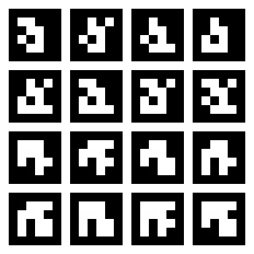
ArUco
An ArUco marker is a square marker composed by a black border and an inner binary matrix which determines its identifier.
Some ArUco markers

Slide 5












DATASET
...
Original ArUco
Some perspective transformations
Some random edge occlusions
Some rotation and flip tranformations

Slide 6
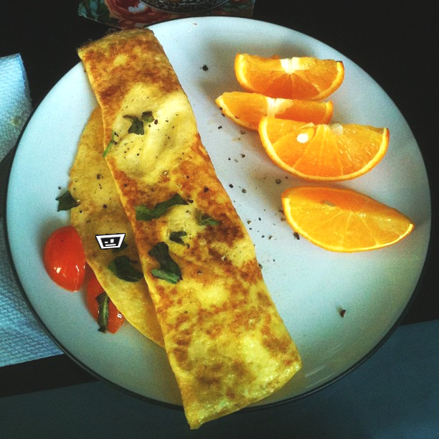



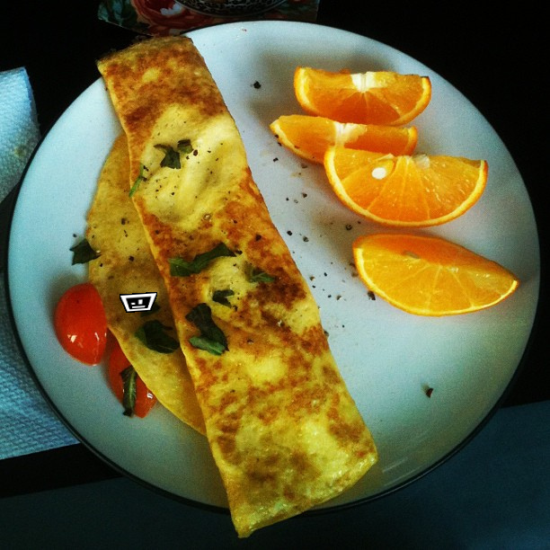



DATASET
For each ArUco transformation
Canny Edge Detection
ArUco mask
Randomly make a brightness transformation
Make the overlay
COCO dataset
Choose random images from COCO dataset

Slide 7
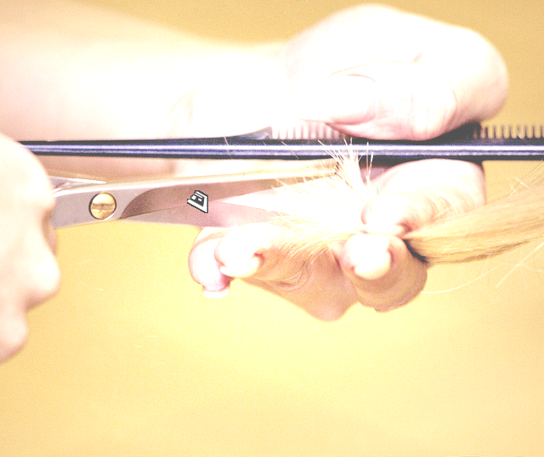



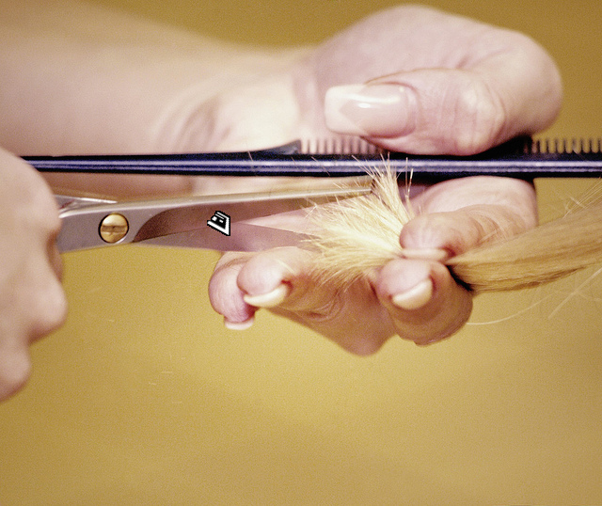

DATASET (Occluded ArUco)
For each ArUco transformation
Canny Edge Detection
ArUco mask
Randomly make a brightness transformation
Make the overlay
COCO dataset
Choose random images from COCO dataset

Slide 8
STATE-OF-THE-ART NEURAL NETWORKS
The neural network that was used is YOLO (You Only Look Once), in particular YOLOv3 and YOLOv5 were used.
YOLO is a convolutional neural network (CNN) for the real-time object detection.
The algorithm applies a single neural network to the full image dividing it into regions.

Slide 9
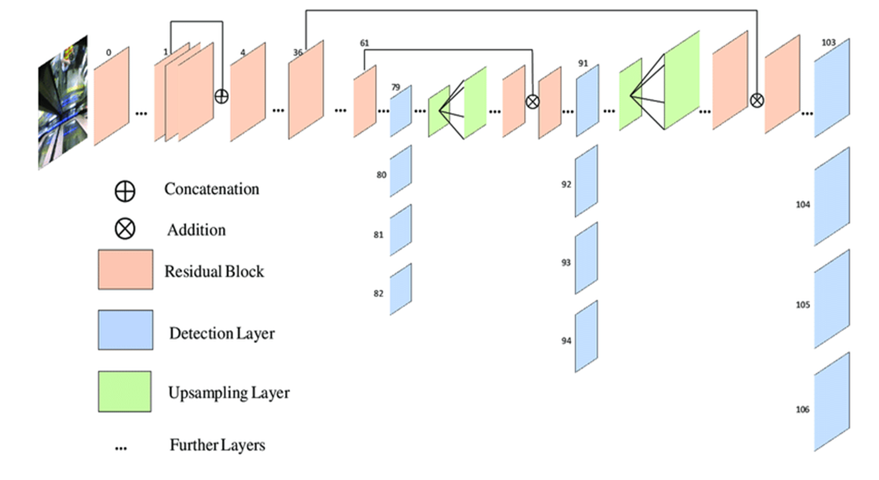
YOLO V3
YOLOv3 uses Darknet-53 as its backbone feature extractor.
YOLOv3 increased the AP for small objects.
In YOLOv3, given an input image, what you get is a multiscale prediction.
Redmon, Joseph, and Ali Farhadi. "Yolov3: An incremental improvement." arXiv preprint arXiv:1804.02767 (2018).

Slide 10
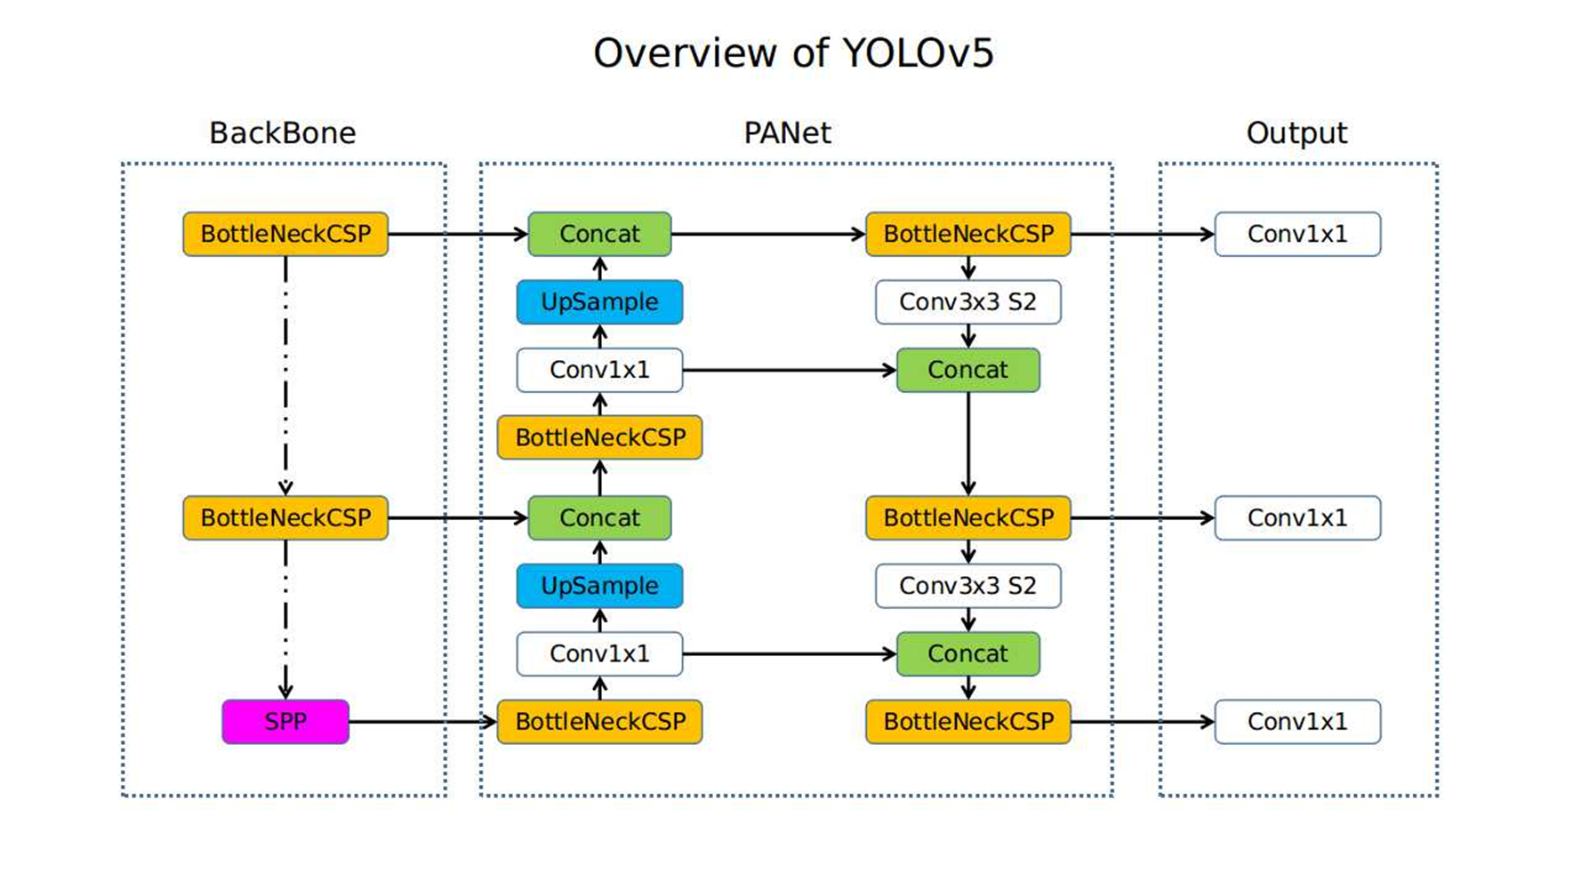
YOLO V5
The YOLO v5 has three important parts:
-Backbone
-Neck
-Head
In YOLO v5 the CSP (Cross Stage Partial Networks) are used as a backbone feature extractor.
For the model Neck YOLO v5 uses PANet (Path Aggregation Network).
Fare clic per inserire testo
https://github.com/ultralytics/yolov5

Slide 11
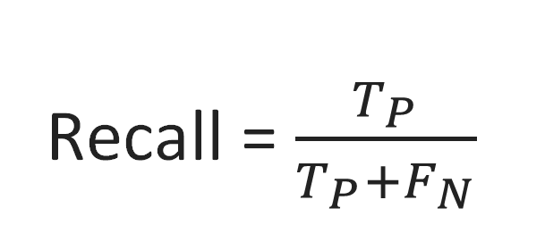
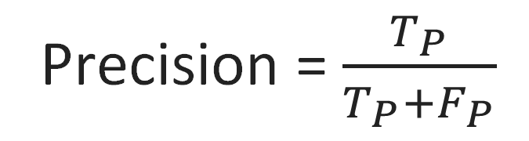
YOLOv3
Class | Images | Labels | Precision | Recall | mAP@.5 | mAP@.5:.95
all | 600 | 600 | 0.975 | 0.969 | 0.989 | 0.87
aruco0 | 600 | 40 | 0.975 | 0.96 | 0.991 | 0.876
aruco1 | 600 | 40 | 0.902 | 0.95 | 0.981 | 0.864
aruco2 | 600 | 40 | 0.949 | 0.923 | 0.968 | 0.86
aruco3 | 600 | 40 | 1 | 1 | 0.995 | 0.868
aruco4 | 600 | 40 | 0.928 | 0.967 | 0.979 | 0.863
aruco5 | 600 | 40 | 1 | 0.961 | 0.993 | 0.89
aruco6 | 600 | 40 | 1 | 0.995 | 0.995 | 0.868
aruco7 | 600 | 40 | 0.942 | 1 | 0.99 | 0.866
aruco8 | 600 | 40 | 0.998 | 0.975 | 0.995 | 0.868
aruco9 | 600 | 40 | 1 | 0.998 | 0.995 | 0.869
aruco10 | 600 | 40 | 0.977 | 0.975 | 0.995 | 0.908
aruco11 | 600 | 40 | 1 | 0.983 | 0.955 | 0.886
aruco12 | 600 | 40 | 0.974 | 0.925 | 0.986 | 0.845
aruco13 | 600 | 40 | 1 | 0.977 | 0.995 | 0.872
aruco14 | 600 | 40 | 0.974 | 0.943 | 0.981 | 0.845
Precision = $\frac{T_{P}}{T_{P}+F_{P}}$
Performance
Recall = $\frac{T_{P}}{T_{P}+F_{N}}$

Slide 12
YOLOv5
Class | Images | Labels | Precision | Recall | mAP@.5 | mAP@.5:.95
all | 600 | 600 | 0.784 | 0.724 | 0.803 | 0.654
aruco0 | 600 | 40 | 0.604 | 0.75 | 0.611 | 0.501
aruco1 | 600 | 40 | 0.614 | 0.75 | 0.761 | 0.62
aruco2 | 600 | 40 | 1 | 0.437 | 0.74 | 0.609
aruco3 | 600 | 40 | 0.806 | 0.825 | 0.897 | 0.689
aruco4 | 600 | 40 | 0.542 | 0.725 | 0.651 | 0.54
aruco5 | 600 | 40 | 0.916 | 0.813 | 0.913 | 0.763
aruco6 | 600 | 40 | 0.879 | 0.729 | 0.878 | 0.66
aruco7 | 600 | 40 | 0.779 | 0.375 | 0.637 | 0.534
aruco8 | 600 | 40 | 0.926 | 0.941 | 0.978 | 0.822
aruco9 | 600 | 40 | 0.604 | 0.775 | 0.703 | 0.591
aruco10 | 600 | 40 | 0.891 | 0.975 | 0.97 | 0.806
aruco11 | 600 | 40 | 0.833 | 0.775 | 0.908 | 0.744
aruco12 | 600 | 40 | 0.826 | 0.948 | 0.95 | 0.749
aruco13 | 600 | 40 | 0.869 | 0.499 | 0.79 | 0.657
aruco14 | 600 | 40 | 0.668 | 0.55 | 0.661 | 0.526
Precision = $\frac{T_{P}}{T_{P}+F_{P}}$
Performance
Recall = $\frac{T_{P}}{T_{P}+F_{N}}$

Slide 13
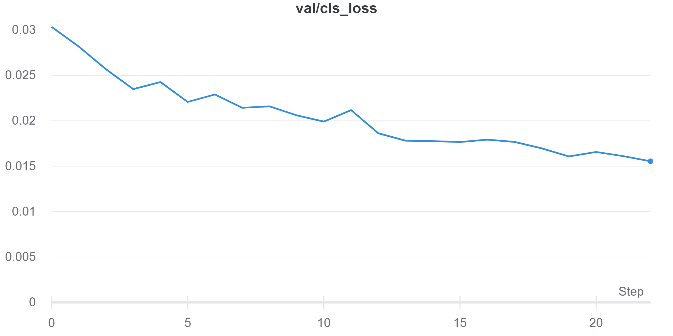
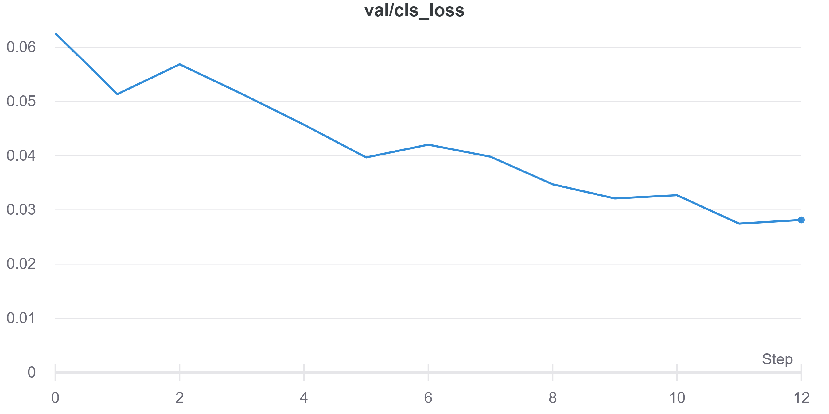
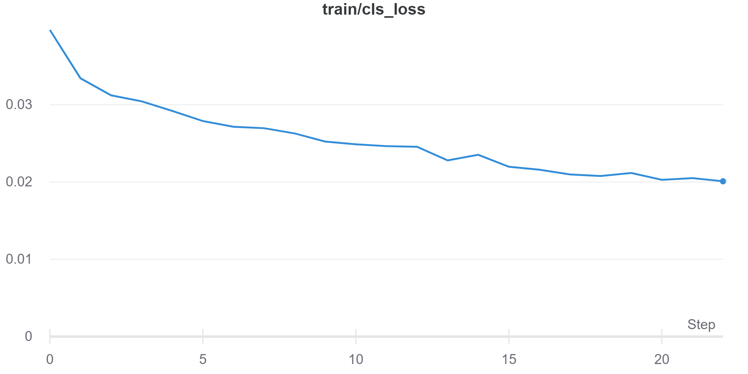
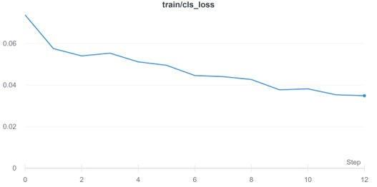
YOLOv3
YOLOv5
Performance

Slide 14
FUTURE DEVELOPMENTS
Dataset construction:
✔️Implemention of rotation, flip and brightness transformations
✔️Implemention of ArUco edge occlusions
● Implemention of other occlusions (for instance, occlusions of the corners or of the centre of the ArUco).
● Real dataset of the staff from a top-view camera
State-of-the-art Neural Networks:
✔️ YOLOv3
✔️ YOLOv5
● Using other state-of-the-art networks, for instance SSD.

Slide 15
THANK YOU FOR YOUR ATTENTION!

